Slide 1




Benefits Overview
Effective October 1, 2024

Slide 2

Agenda
What is Open Enrollment?
What are my Resources?
Benefit Summary
Detailed Benefit Overview
Questions?

Slide 3

What is Open Enrollment?
A TIME TO ENROLL
New Hires
Current Employees
Dependents and Beneficiaries
TYPICALLY, WHEN PLAN CHANGES OCCUR
Potential new coverages, carriers, or plans
Potential plan changes, coverage options, carriers
A TIME TO MAKE CHANGES
Add or Drop Dependents
Change Plans
Waive Coverage
Update Beneficiaries
BENEFITS ARE EFFECTIVE OCTOBER 1
You can only change elections after OE only if you experience a Qualifying Life Event (QLE)
Open Enrollment will take place Wednesday, August 21 - Thursday, August 29 and is mandatory. You are required to log in to confirm your elections regardless of whether you are making changes or waiving coverage.

Slide 4

What is a Qualifying Life Event (QLE)?
A “life change” which enables employees to enroll or change benefits outside of open enrollment.
Some examples are:
  Birth or Adoption of a Child
  Marriage, Divorce or Legal Separation
  Death of a Legal Spouse or Dependent Child
  Change in your Spouse’s employment status that results in a loss or gain of coverage

Slide 5

Who is Eligible to Enroll?
Employees
  You are eligible if you are an active, full-time employee scheduled to work at least 30 hours per week.
  New employees are eligible to participate on the first of the month following date of hire.
  Permanent part-time employees that work more than 28 hours per week or 1,456 annual hours are also eligible to enroll in medical, dental, and vision benefits.
Eligible Dependents
  Your legal spouse
  Your natural children, step-children or adopted children up to age 26
  Disabled dependents (proof of disability is required)
When including a dependent on your benefits, proof of eligibility will be required. Proof of eligibility may include marriage license, birth certificate, adoption papers, or other legal documents that prove eligibility under the plan.

Slide 6

What are my Resources?
BENEFIT GUIDE
Emailed & Posted on the Web Benefits Portal
VIRTUAL BENEFIT MEETINGS
Friday, August 23 at 9:00 AM
IN-PERSON BENEFIT MEETINGS
Wednesday, August 21 at 10:00 AM (Annex)
Thursday, August 22 at 10:00 AM (Fire Station)
Monday, August 26 at 2:30 PM (Fire Station)
Q&A
Have a question? We are available after the benefit meetings and webinars to respond to your individual questions.
Call or email: 678-540-1428 or woodstock@a2benefits.com

Slide 7

Who is a2 benefits?
We have a dedicated Benefit Service Team here to assist you!
  Looking for an In-Network Provider or Pharmacy?
  Need assistance with a claim question or issue?
  Have a question about your Benefits or Coverage details?
  Call or email
    678-540-1428 or woodstock@a2benefits.com

Slide 8

What is HealthJoy?
HealthJoy is your virtual Healthcare Assistant. Your first stop for all your healthcare needs!
  Access and understand your benefits
  A virtual wallet for ID cards
  On-demand LIVE help
  Make smart choices
  Save time and money
  Chat or phone 24/7/365
  Telemedicine – consult with a doctor online 24/7/365
  Download the app today!

Slide 9



2024 Benefit Summary
MEDICAL
Renewing with UMR
There are no changes to plan designs for Basic & Premium. The deductible on the HDHP is increasing to remain compliant with IRS regulations.
There are no changes to contributions
LIFE / DISABILITY / EAP
Renewing with New York Life with no plan changes; increasing LTD max
There are no changes to contributions
TELEMEDICINE
Continuing with HealthJoy
DENTAL
Renewing with Guardian; increasing the annual max to $1,500
There are no changes to contributions
WELLNESS
Continuing with TargetCare for our Wellness Points Tracking
VISION
Renewing with EyeMed
There are no changes to plan designs or contributions
FLEXIBLE SPENDING & HEALTH SAVINGS ACCOUNTS
Renewing with UMR / Optum

Slide 10
Medical & Rx

Slide 11

Medical Benefits
In-Network | Basic | Premium | HDHP
Calendar Year Deductible Employee / Employee + Spouse or Child / Family | $2,000 / $4,000 / $6,000 | $1,000 / $2,000 / $3,000 | $1,600 / $3,200 / $3,200
Coinsurance | 80% / 20% | 90% / 10% | 90% / 10%
Out-of-Pocket Max (OOPM) Employee / Employee + Spouse or Child / Family | $3,000 / $6,000 / $9,000 | $1,500 / $3,000 / $4,500 | $2,250 / $4,500 / $4,500
Office Visits Preventative Primary Specialist Urgent Care | Covered at 100% $25 Copay $35 Copay $35 Copay | Covered at 100% $25 Copay $35 Copay $35 Copay | Covered at 100% Deductible + 10% Deductible + 10% Deductible + 10%
Emergency Room | $250 Copay | $250 Copay | Deductible + 10%
Inpatient & Outpatient | $250 Copay per Admission then Deductible + 20% | $250 Copay per Admission then Deductible + 10% | Deductible + 10%
Employer HSA Contribution | None | None | Individual $750 / Family $1,500
Network | UnitedHealthcare Choice Plus Network
All plans include out of network benefits, please refer to the benefit summaries for details.

Slide 12

Rx Benefits
Prescription Coverage | Basic | Premium | HDHP
Rx Out-of-Pocket Max (OOPM) Employee / Employee + Spouse or Child / Family | Combined with Medical | Combined with Medical | Combined with Medical
Retail (30 Day Supply)* Generics Tier 1 Brand Tier 2 Preferred Brand Tier 3 Specialty Tier 4 | $15 Copay $30 Copay $60 Copay 25% to $200 | $15 Copay $30 Copay $60 Copay 25% to $200 | Deductible + 10% Deductible + 10% Deductible + 10% Deductible + 10%
Mail Order Maintenance (90 Day Supply) Tier 1 / 2 / 3 | $25 Copay / $60 Copay / $120 Copay | $25 Copay / $60 Copay / $120 Copay | Ded. then 10% Co-ins to OOPM
Formulary | Liviniti Core Formulary
•Find your formulary at Liviniti member page https://liviniti.com/members/ and use your group code: 76411860 to search for your medications.
*Copays for Tiers 1 – 3 increase by $10 if you do not use a First-Choice Pharmacy; Tier 4 increases to 25% to $250

Slide 13
Medical/ Rx – Contributions
Bi-Weekly (26) | Basic | Premium | HDHP
Non-Tobacco User - Participating in Wellness (Both Wellness & Tobacco Discounts) | $31.12 | $101.15
Employee | $28.83 | $39.96 | $6.96
Employee + Spouse | $106.42 | $118.02 | $82.23
Employee + Child(ren) | $80.95 | $97.25 | $65.15
Family | $164.02 | $181.90 | $126.74
Bi-Weekly (26) | Basic | Premium | HDHP
Tobacco User - Not Participating in Wellness (No Discounts) | $31.12 | $101.15
Employee | $98.06 | $109.19 | $76.19
Employee + Spouse | $175.65 | $187.25 | $151.46
Employee + Child(ren) | $150.18 | $166.48 | $134.38
Family | $233.25 | $251.13 | $195.97

Slide 14
Medical/ Rx – Contributions
Bi-Weekly (26) | Basic | Premium | HDHP
Non-Tobacco User – Not Participating in Wellness (Non-Tobacco User Discount Only) | $31.12 | $101.15
Employee | $63.45 | $74.58 | $41.58
Employee + Spouse | $141.04 | $152.64 | $116.85
Employee + Child(ren) | $115.57 | $131.87 | $99.77
Family | $198.64 | $216.52 | $161.36
Bi-Weekly (26) | Basic | Premium | HDHP
Tobacco User - Participating in Wellness (Wellness Discount Only) | $31.12 | $101.15
Employee | $63.45 | $74.58 | $41.58
Employee + Spouse | $141.04 | $152.64 | $116.85
Employee + Child(ren) | $115.57 | $131.87 | $99.77
Family | $198.64 | $216.52 | $161.36

Slide 15
Medical Plan Comparison Examples
Joe’s Simple Fracture (in-network emergency room visit & follow up care)
Basic | Premium | HDHP
Plan Details: Plan Deductible: $2,000 Specialist Copay: $25 Hospital Facility Coinsurance: $250 Other Coinsurance: 20% | Plan Details: Plan Deductible: $1,000 Specialist Copay: $25 Hospital Facility Coinsurance: $250 Other Copay: 10% | Plan Details: Plan Deductible: $1,600 Specialist Coinsurance: 10% Hospital Facility Coinsurance: 10% Other Coinsurance: 10%
Services in this example: Emergency room visit (including medical supplies), X-Ray, Durable medical equipment (crutches), Visits for Rehabilitation services (physical therapy)
Total Example Cost: $2,600 | Services in this example: Specialist office visits, Childbirth/ Delivery Professions & Facility Services, Diagnostics Tests, Specialist visit | Services in this example: Specialist office visits, Childbirth/ Delivery Professions & Facility Services, Diagnostics Tests, Specialist visit
Cost Sharing: Deductible: $300 Copays: $400 Coinsurance: $200 Limits or Exclusions: $0 | Cost Sharing: Deductible: $300 Copays: $400 Coinsurance: $100 Limits or Exclusions: $0 | Cost Sharing: Deductible: $1,600 Copays: $0 Coinsurance: $100 Limits or Exclusions: $0
Total Joe would pay: $900 | Total Joe would pay: $800 | Total Joe would pay: $1,700
•Remember to also include your employee contribution amounts

Slide 16

How to find a Medical Provider
There are several ways to find an in-network provider
  Contact your provider and ask if they are in-network with: “UnitedHealthcare Choice Plus Network”
  Call the number on the back of your ID card
  Via www.UMR.com; select “Find a Provider,” then search “UnitedHealthcare Choice Plus Network”. For medical providers, choose “Search for a medical provider.” For behavioral health providers (including counseling and substance abuse) select “View directory of behavioral health providers”
  Remember to look for a Premium Designated Provider for a $10 lower copay with the Basic or Premium Plan.

Slide 17
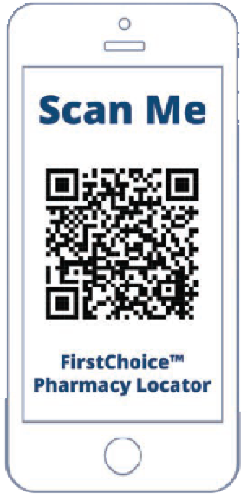
First Choice Pharmacies
Members of Liviniti (formerly Southern Scripts) have access to reduced prescription costs at participating First Choice pharmacies.
  There is a copay differential for First Choice pharmacies. The copay will be $10 higher for Tier 1-3 drugs and up to $25 higher for specialty drugs if you choose to utilize a non-First Choice pharmacy. Walmart, Kroger and Publix are examples of First-Choice pharmacies.
  Visit www.liviniti.com/members/firstchoice to find the pharmacy nearest you!

Slide 18

Variable Copay Program
Designed to significantly reduce the cost of eligible specialty and brand medications by utilizing manufacturer-provided coupons.
  Potentially reduces plan and member costs by utilizing manufacturer-provided coupons. After your out-of-pocket (OOP) is satisfied, the remaining dollars bring drug cost savings to your employer.
  Medication arrives at your doorstep monthly via a shipping courier (– approximately 5-7 days before your current medications are completed.
  Must be enrolled in the Basic or Premium plans (HDHP is not eligible to participate).
  To enroll in this program call (833) 439-9617 or login to the Liviniti mobile app.

Slide 19

International Mail Order
The Intl Mail Order program is a voluntary prescription drug program that’s offered by Liviniti
  This program is available to employees and dependents.
  Medications are filled for 90 days (prescription must be written for 90 days)
  It’s simple to enroll, safe, and free. There are 300+ brand name drugs available at no cost and shipping & handling is covered by the program!
  To see if your drug is covered visit www.IntlMailOrder.com or call 1-866-488-7874

Slide 20
7-Day Opioid Limits
There is a 7-day limit on Opioids for an initial opioid prescription for members new to pain management therapy.
  Limit Two Prescriptions of 7-Day Supply within a 90-day period
  No Extended-Release Opioids allowed for acute pain
  Quantity Limit of Four immediate-release opioid tablets per day
  Contact Liviniti Account Team for more information on this program at www.liviniti.com or 800.710.9341

Slide 21

Get the Most, For the Least
PREVENTIVE CARE
Always covered 100% when In-Network
URGENT CARE & TELEMEDICINE
Consider these options when health crisis is less than life threatening
MAIL ORDER!
Receive a 90 Day supply for less than the Retail Cost
International Mail Order is available also
GENERIC DRUGS & PUBLIC DRUG PROGRAMS
Always ask for a Generic alternative, and consider Public Drug Programs at grocery stores, Target, Wal-Mart, etc.
GOODRx
Save up to 80% on your prescription drug prices simply by using the GoodRx app. Search & Compare Prices, Save To My RX, Show To Your Pharmacist
Notes:
Kroger (Savings Club): Annual Membership is $36 individual or $72 family of up to 6 people including pets. Then 100+ common prescriptions are Free, $3 or $6
Publix: $4 for a 30- day supply of select generic medications- hundreds are available
Wal-Mart: $4 for a 30- day supply or $10 for a 90- day supply of select generic medications

Slide 22
Dental & Vision

Slide 23

Dental
 | Network Access Plan | Value Plan
 | For those using Out-of-Network Providers | For those using In-Network Providers
Calendar Year Deductible Individual Family | $50 $150 | N/A N/A
Annual Plan Maximum (Preventative does not reduce annual plan max) | $1,500 | $1,500
Coinsurance Preventative Basic Major | 100% 80% 50% | 100% 100% 60%
Orthodontia (Child Only – up to 19) Coverage Lifetime Max | 50% $1,000 | 50% $1,000
Out-of-Network Reimbursement | 90th UCR | Maximum Allowable Cost (MAC) Fee Schedule
Increased Annual Max

Slide 24


Dental Rollover Benefit
Guardian provides the opportunity for members to roll over a portion of their unused annual maximum through a rollover benefit.
  There is a $1,500 annual maximum for Basic and Major services combined.
  In order to earn the Maximum Rollover Amount (MRA), a member must submit a claim but not exceed the paid claims threshold during the benefit year.
  Every covered member has his or her own MRA and the MRA can be used for future expenses as long as the member is active on the plan.
  If you have questions on your rollover maximum balance, contact Guardian directly.

Slide 25
How to find a Dental Provider
There are several ways to find an in-network provider
  Contact your provider and ask: “Do you participate in the Guardian DentalGuard Preferred network”
  Contact Guardian at 800.541.7846
  Via the www.guardianlife.com; Select “ “Find a Provider” at the top of the screen. Select “DentalGuard Preferred” as your plan type and search by location or name.

Slide 26

Vision
 | In-Network | Out-Of-Network Reimbursement
Exam | $10 Copay | Up to $35
Lenses
Single Vision | $25 Copay | Up to $25
Bifocal | $25 Copay | Up to $40
Trifocal | $25 Copay | Up to $60
Frames | $120 Allowance, plus 20% discount off remaining balance | Up to $48
Contact Lenses (in lieu of frames and lenses) | $135 Allowance, plus 15% discount off remaining balance | Up to $95
Laser Vision Correction | 15% off retail price or 5% off promotional price | No Coverage
Exam / Frame / Lenses or contacts | Once every 12 / 24 / 12 months

Slide 27
How to find a Vision Provider
There are several ways to find an in-network provider
  Contact your provider and ask: “Do you participate in the EyeMed Select vision network”
  Contact EyeMed at 866.939.3633
  Via www.eyemedvisioncare.com; click on “Find an eye doctor” at the top of the screen; then choose the “Select” network

Slide 28
Dental / Vision – Contributions
Dental | Network Access Plan | Value Plan
 | Bi-Weekly (26)
Employee | $0.00 | $0.00
Employee + 1 (Spouse or Child) | $12.30
Family | $19.41
Vision
 | Bi-Weekly (26)
Employee | $2.58
Employee + 1 (Spouse or Child) | $4.89
Family | $7.16

Slide 29
Wellness Programs

Slide 30




TargetCare Wellness
In an effort to promote a healthy workplace and strive to keep everyone’s cost for health care coverage affordable, the City offers a Wellness Plan.
Employees on the medical plan can earn this reward by participating in the below:
1. Clinical Health Assessment (CHA)
2. Review of Results
3. Ongoing Health Coaching Program

Slide 31
TargetCare Wellness – CHAs
Onsite CHA
Event Dates
Annex:
  October 15th
  October 16th
Fire Station 14:
  October 15th
  October 16th
  October 17th
Targetcare will be onsite for the Clinical Health Assessments again this year
The Wellworks platform will open on September 18th, through this portal you will complete your consent form, questionnaire and schedule your appointment.
Once you complete your CHA, you will need to log back into the health portal to schedule your review with a TargetCare nurse.
  Remember – you must also complete your review to receive the wellness incentive given by the City of Woodstock!
If you had a Risk Score of 81 or higher last year, your risk score must have reduced by at least 5% at the 2024 CHA to receive the wellness incentive.

Slide 32
TargetCare Wellness – RAS
Right on Target Health Coaching Program
Extremely High Risk (>100): It is required you meet with the TargetCare healthcare provider at least every four (4) weeks for assistance in gaining control of existing conditions and/or modifying current health risk factors.
High Risk (81-100): It is required you meet with the TargetCare healthcare provider at least every eight (8) weeks to discuss your current health risks and set goals to help manage existing conditions.
Borderline High Risk (61-80): It is required you meet with the TargetCare healthcare provider every eight (8) weeks for at least three visits to discuss preventive measures to lower your chance of developing chronic diseases.
Above Normal Risk (41-60): It is required you meet with the TargetCare healthcare provider within sixteen (16) weeks to discuss your health and your personal management of your risks.
Optimal or Normal (0-40): There are no further requirements to meet with the TargetCare healthcare provider. You are still encouraged to speak with the provider if you desire, but it is optional.
Reasonable Alternative
Standard (RAS) Program:
If you have a risk score of 81 or higher, you must enter and be compliant with the RAS program to maintain your wellness incentive.
  If you are in this category,
  your risk score must have reduced by at least 5% at the 2024 CHA in order to receive the wellness incentive.
You and your health coach will design a customized RAS program for you to help you meet your goals.

Slide 33

TargetCare Wellness
There are many benefits of participating the Targetcare Wellness program:
  You will earn a lower premium on your medical insurance!
  CHA’s can help detect chronic diseases early and educate individuals on steps they need to take before they become more serious.
  You will have access to the onsite TargetCare clinic for acute care and minor illness needs, such as
    Common cold, bronchitis, acne, fever, sinus infection, sore throat, minor skin infections, and so much more!
  There are no copays for visiting the clinic, as well as no copays for prescriptions if written in clinic.

Slide 34

TargetCare Wellness
The City of Woodstock offers a wellness and rewards program through TargetCare to help you achieve your health and wellness goals
  Earn up to $250 annually in gift cards through the rewards mall by completing a combination of scorecard activities
  To access your account, visit targetcarehealth.com or download the mobile app:
    Username: COW + First Initial of First Name + Last Name + Last 4 digits of Social Security Number (Ex. John Smith 000-00-1234 would be COWJSmith1234)
    Password: First Initial of First Name + Last Name + DOB (MMDD) (Ex. John Smith DOB 01/01/1990 would be JSmith0101)

Slide 35




Wellness through Onelife Fitness
City employees are eligible for a DISCOUNTED MEMBERSHIP of only $7.99 per month to Onelife Fitness for the Basic membership which provides free group fitness classes at their facility located at 301 Gold Creek Trail off Highway 92.
Once you have registered with the Woodstock location, you can use any of the Atlanta area locations.

Slide 36

Tobacco Program
The City strives to improve the overall health and wellness of its employees and the impact it will have on the cost of healthcare, the City will maintain the current tobacco surcharge of $75 per month.
  In order to receive the discounted rate on your premiums, you will be required to complete an affidavit stating that you are and have been tobacco-free for the past 90 days.
  This affidavit question will be available through your online enrollment with Employee Navigator under the medical section.
  In addition, the City provides resources through Liviniti (formerly Southern Scripts) and TargetCare to enable you to accomplish your goal. You can utilize one or more of the following resources to become tobacco free. Reach out to a2 for more info!

Slide 37


NEW: Chronic Care Management
Live healthier at no cost to you! Discover care and support for chronic conditions with smart devices, expert coaches, and easy to follow, personalized plans. Available plans include:
  Diabetes Management
    Connected meter and unlimited strips
  Weight Management & Diabetes Prevention
    Connected scale and expert guidance
  Hypertension
    Connected monitor and one-on-one coaching
Do You Qualify?
Visit TeladocHealth.com/Smile
Or call 800-835-2362

Slide 38
Tax-Advantaged Accounts

Slide 39


Tax-Advantaged Accounts
You have four tax-advantaged account options available to you through the City of Woodstock:
  Flexible Spending Accounts (FSA)
    Healthcare FSA
    Limited Purpose FSA
    Dependent Care FSA
  Health Savings Accounts (HSA)

Slide 40
Health Savings Account
Being enrolled in the HDHP Medical plan option gives you access to a Health Savings Account (HSA). This is an account that allows you to set aside tax-free dollars to save money to pay for eligible healthcare expenses!
The City of Woodstock will contribute $750 for individual and $1,500 for family tiers.
You can view your account details through your UMR account login or on Optum directly.
The account belongs to you and you take it with you should you ever leave the City.
Individual Maximum | Family Maximum
$4,150 | $8,300
If you are over 55, you can contribute an additional $1,000 per year.
(Maximums include City of Woodstock employer contributions)

Slide 41
Flexible Spending Accounts
Flexible Spending Accounts (FSAs) enable you to put aside money for out-of-pocket health related expenses. FSAs are a way of using pre-tax payroll deductions to pay for either dependent care or non-reimbursable health expenses.
City of Woodstock’s FSA is on a plan year which runs from October 1 to September 30
Healthcare & Limited Purpose FSA | Dependent Care FSA
Maximum Contribution $3,200 Up to $640 carryover available | Maximum Contribution $5,000 No carryover – “Use it or lose it”
FSA Elections do not rollover, you must re-enroll in this benefit each year if you would like to participate!

Slide 42
Tax-Advantaged Account Comparison
 | HSA | Healthcare FSA | Limited- Purpose FSA | Dependent Care FSA
2024 Maximum Contributions | Employee: $4,150 Family: $8,300 | $3,200 | $3,200 | $5,000 ($2,500 if married and filing separate income tax returns)
Who is eligible? | Employees who elect the the HDHP Medical | Employees who elect the Basic or Premium Plans | Employees who elect the the HDHP Medical | Anyone
Eligible Expenses | *Medical, Dental, Vision and Pharmacy Expenses for your and your dependents | Medical, Dental, Vision and Pharmacy Expenses for your and your dependents | *Dental and Vision Expenses for your and your dependents | Daycare expenses for children under 13, disabled dependent care and elder care expenses
Carryover | Entire account balance | Up to $640 per year | Up to $640 per year | None – Use it or Lose it!
Funds Available | Only available as payroll deducted. City makes a lump sum payment of $250 Employee or $750 any other tier the 1st payroll in October | All funds available at the beginning of the plan year | All funds available at the beginning of the plan year | Only available as payroll deducted
*If you enroll in an HSA and a Limited Purpose FSA, dental & vision expenses can be reimbursed from either account, but
the same expenses can’t be reimbursed from both accounts. You can’t “double dip”!

Slide 43
Examples of Eligible FSA/HSA Expenses
Orthodontia treatment
Prescription copays
Chiropractic
Contraceptive prescriptions
Psychiatrist/Counseling
Durable medical equipment
Lasik eye surgery
Medical plan deductible & coinsurance
Dental plan deductible & coinsurance
Contact solutions, cleaners
Vision expenses
Eyeglasses
Contact lenses
Diabetic supplies
Medical plan office visit copays
Visit the below for more examples of qualified expenses:
IRS.gov
HSAstore.com
FSAstore.com

Slide 44
Life & Disability

Slide 45

Basic Life and AD&D
City of Woodstock provides all full-time employees with a Basic Life Benefit and an additional Accidental Death and Dismemberment benefit. AD&D may pay benefits if you die or suffer from certain serious injuries as a result of an accident.
OR
Employee Benefit: $50,000 Life and
$100,000 AD&D, Employer Paid!

Slide 46
Voluntary Life and AD&D
Employee Benefit: Increments of $10,000 up to 5x earnings or $500,000
Spouse Benefit: Increments of $5,000 up to $250,000, not to exceed the employee amount
Child Benefit: Birth to 6 months - $1,000; 6 months to 26 years - $10,000 / AD&D Flat $10,000
Guarantee Issue (GI):
Employee: $150,000
Spouse: $50,000
Child: $10,000
OR
Important Notes:
You must be enrolled in Employee voluntary life / AD&D in order to elect voluntary dependent Life / AD&D coverage.
The AD&D is non-matching so you can enroll in a different amount of AD&D than life. However, you must enroll in the voluntary life to elect AD&D. (AD&D does not require EOI).
See the benefit guide, portal or Employee Navigator for rates. Premium increases as enrollee jumps into the next age bracket. Spouse rates are based on the employee age.

Slide 47

Disability Insurance
The City of Woodstock believes that you should have income protection if you are unable to work as a result of illness, injury or an approved maternity leave, offering you the below benefits for disability coverage.
  Voluntary Short-Term Disability
  Employer-Paid Long-Term Disability

Slide 48
Disability Insurance
Voluntary Short-Term Disability
Long-Term Disability
Increased Maximum!
EMPLOYEE PAID
Provides 60% of your weekly income up to $2,000 per week
Benefits begin on the 15th day after accident or sickness
The maximum benefit period is 11 weeks
Pre-Existing Conditions: 3/12
EMPLOYER PAID
Provides 60% of your monthly salary up to $10,000 per month
Benefits begin after 90 days of disability
Any long-term disability benefit paid to you is offset by any state-mandated disability benefits you receive

Slide 49

Financial, Legal & Estate Support
NYL’s Financial, Legal & Estate Support Program helps you navigate financial and legal challenges which can be very stressful for you and your family. This benefit is offered at no cost. The program includes:
  Financial Connect – access to a team of qualified experts including CPAs and Certified Financial Planners
  Legal Connect – gives you access to unlimited phone consultations with a staff of attorneys who can provide guidance on issues such as divorce, adoption, estate planning, real estate and identify theft
  EstateGuidance – a user friendly online tool you and your family can access to write a last will and testament, a living will and other documents outlining your wishes for final arrangements
  Phone: (800) 344-9752
  Website: guidanceresources.com (web ID: NYLGBS)

Slide 50

Secure Travel
New York Life Secure Travel offers additional protection when you travel. They have assistance available for pre-trip planning, assistance while traveling and emergency medical transportation benefits for covered persons traveling 100 miles or more from home. Service is a phone call away, 24/7/365.
  From the United States and Canada, call (888) 226-4567
  From other locations, call collect (202) 331-7635
  Fax: (202) 331-1528
  Email: ops@us.generaliglobalassistance.com

Slide 51
EAP Programs

Slide 52

Employee Assistance & Wellness Support
Life: just when you think you’ve got it figured out, along comes a challenge. NYL’s suite of value-add resources includes:
  Employee Assistance Program - provides support through unlimited telephone access to EAP professionals 24 hours a day, seven days a week. You also have up to 3 face-to-face sessions with a counselor (per issue per year). Visits are 100% confidential & are provided to you through your employer at no cost to you; If additional resources are needed your EAP will help locate the appropriate resources in your area
  Guidance Resources – Resources and tools on topics such as health and wellness, legal regulations, family & relationships, work & education, money & investments, and home & auto.
  Well-being Coaching – To help you achieve your goals, you have access to a certified coach wo will work with you one-on-one to address issues such as burnout, time management & coping with stress.
  Phone: (800) 344-9752
  Website: guidanceresources.com

Slide 53


Employee Assistance Program
We are pleased to continue to offer City employees access to an expanded Employee Assistance Program (EAP) with Thriveworks.
  Thriveworks has a dedicated team available to assist you in scheduling an appointment with licensed professional counselors, coaches, and psychologists and can offer a full spectrum of therapy services.
  To schedule an appointment or request services using your benefits, call the dedicated phone number or visit the link for more information.
  Phone: 855-726-8765
  Website: https://thriveworks.com/partners/enterprise

Slide 54
Voluntary Benefits

Slide 55


Nationwide Pet Insurance
Protecting your four-legged family members in an uncertain world isn’t always easy. Nationwide® pet insurance helps you provide for your pets—and protect your pocketbook—by reimbursing you for eligible veterinary bills related to accidents, illnesses, preventive care and more.
You have the option to choose a plan that best fits your needs at a 70% or 50% reimbursement.
There are options for coverage that include wellness procedures as well.
Pricing varies by what type of pet you cover, and which plan you choose. Note that pre-existing conditions are not covered.
Enrolling is easy! Use the links or phone numbers below:
  Go to http://www.petinsurance.com/woodstockga
  Call 877-738-7874 and mention that you’re an employee of City of Woodstock to receive preferred pricing

Slide 56


Identity Theft Protection
The City provides you the opportunity to purchase a proactive monitoring service that alerts you at the first sign of fraud.
  Get alerts for credit inquiries, accounts opened in your name, unsavory content on your social media account, compromised credentials, and financial transactions and more!
  Enrolling your family extends that protection to anyone in your household.
  Allstate Pro+ plans and pricing: $9.95 per person / month or $17.95 per family / month
  To Enroll: Visit https://www.myaip.com/cityofwoodstock or call 1.800.789.2720

Slide 57


Worksite Products
The City provides you the opportunity to purchase additional coverage to help pay for life’s unexpected moments.
Accident
Pays you directly in the event you have medical expenses associated with an accident.
Examples include:
  Wrist Fracture: $2,000
  Shoulder Dislocation: $1,500
  Torn Tendon: $600
  Ambulance Ride: $200
  Emergency Room: $200
Critical Illness*
Pays you a lump sum when you are diagnosed with a Critical Illness including, but not limited to:
  Cancer
  Heart Attack
  Stroke
  Major Organ Transplant
  End-Stage Renal Failure
  Coronary Artery Bypass
Both plans have a $50 Wellness Screening Benefit available per covered member.

Slide 58
Transition Planning

Slide 59
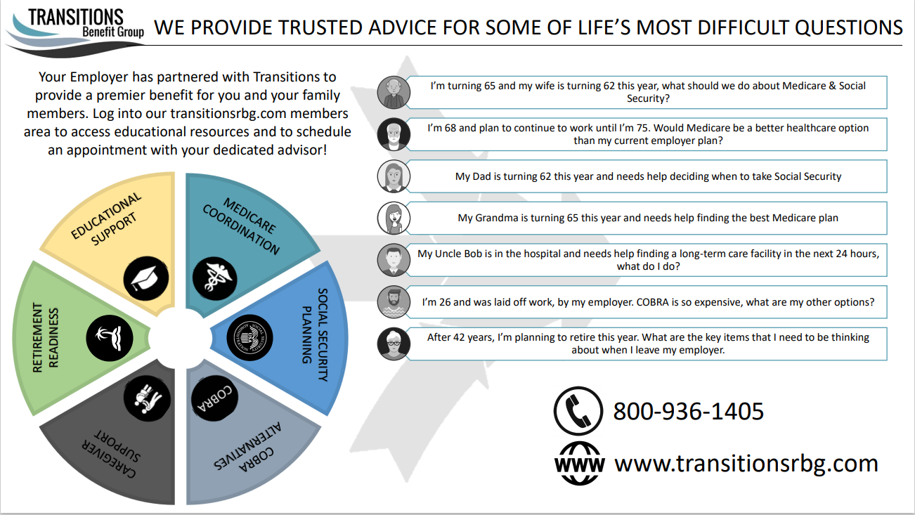
Transition Planning / Medicare Support
Who is Eligible for this
BENEFIT?
Employees
Spouses
Dependents
Loved Ones
Notes:
We would like to highlight Transitions, a partner who can help you, your spouse, or any loved one with support in several areas. They can help you make decisions around when to file for social security income, whether Medicare or GDS’ group health plan would better meet your needs, which medicare supplement would be right for you, and help finding alternatives to COBRA if someone loses access to an employer plan. There is helpful information on their website, or you can call and schedule a time for a personal consultation.

Slide 60
Next Steps

Slide 61
How do I Enroll?
Open Enrollment will take place August 21 through August 29
To enroll in benefits, go to https://employeenavigator.com
New Users
Click “Login” located in the top right-hand corner of the Home Page
Click on Register as a new use located at the bottom of the login screen and enter the following information to create your username and password:
  First Name
  Last Name
  Company Identifier: cityofwoodstock
  Last 4 digits of your social security number
  Date of Birth
Existing Users
If you have forgotten your Username or Password, please click the “Forgot Username” or “Forgot Password” link on the LOG IN screen.

Slide 62
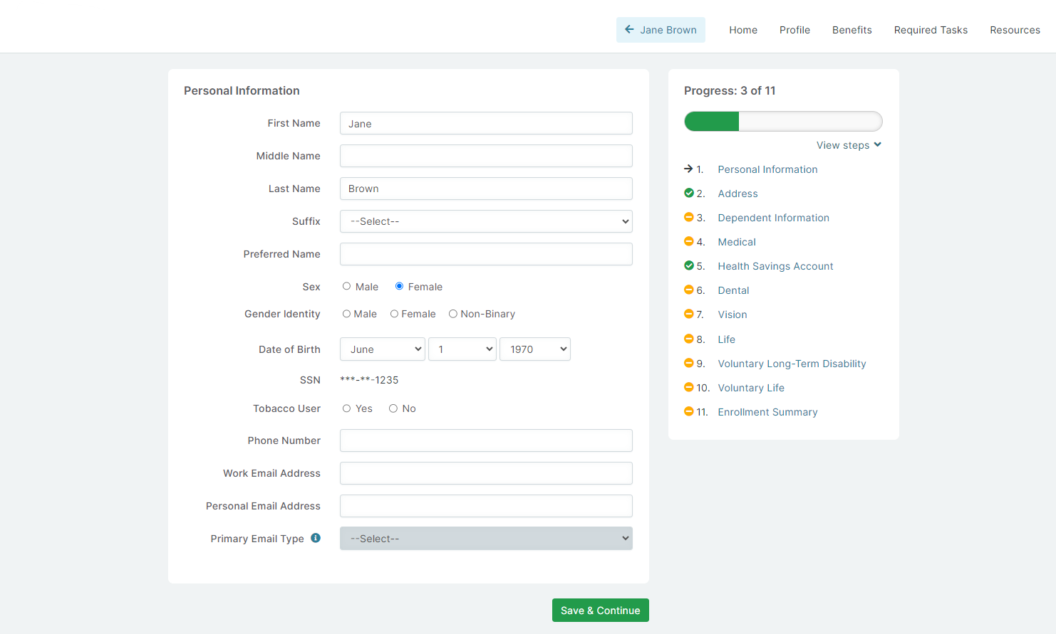
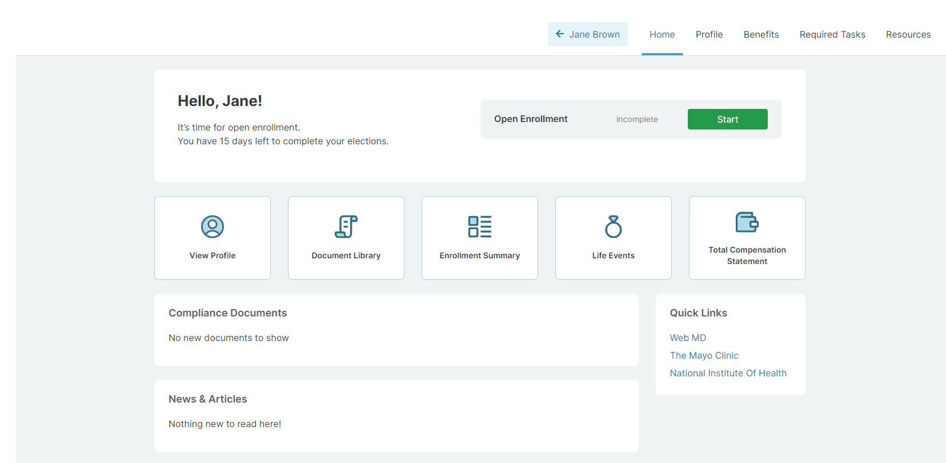
How do I Enroll?
Click “Start” to review/update your personal information. Follow the prompts to add and review your dependents.

Slide 63
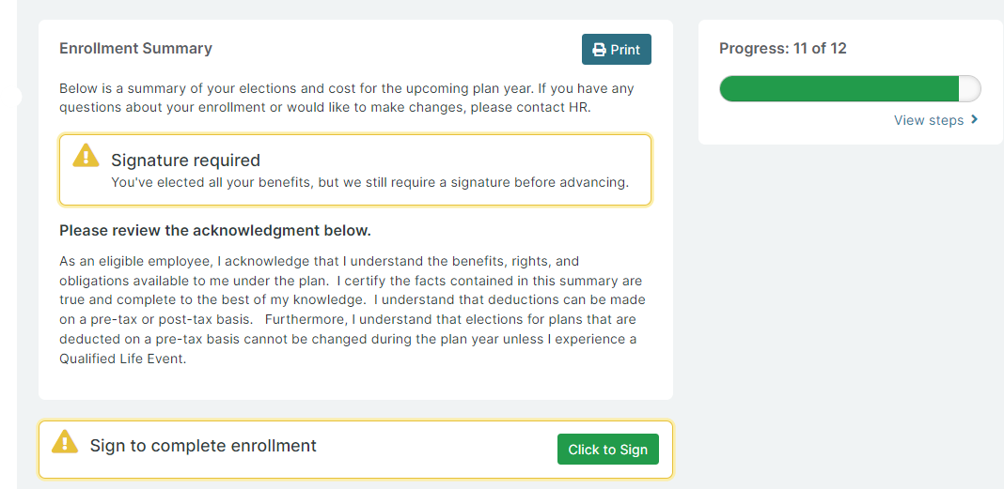
How do I Enroll?
Use the Save & Continue button to view and elect/decline each benefit.
After you make your elections review and sign your enrollment using the button below.

Slide 64
Next Steps
Complete your Enrollment on the enrollment website between August 21 through August 29. Online elections must be made (even if you are waiving coverage) or you risk loss of coverage. Please carefully review your Benefits Guide and plan information.
Be sure to check Beneficiaries for Life coverages and complete any applicable EOIs.
Don’t forget to re-elect FSA if you’d like to participate again.
Call or Email HR or a2 benefits with any questions
  Woodstock@a2benefits.com or (678) 540-1428
You can also visit the benefits portal for information on all your City of Woodstock benefits! https://cowoodstock.a2portal.com/

Slide 65
Questions?

